Slide 1


CITS1003 Introduction to Cybersecurity
[9] Cyber Law and
CI & CPS exercises
Dr Garrison Gao

Slide 2
Privacy preserving
  Secure Multi-Party Computation (SMPC)
  Differential Privacy (DP)
  Homomorphic Encryption (HE)
Implementation vulnerability: Side Channel Attack (e.g., Power, Thermal, Time)

Slide 3
What is privacy
Privacy refers to the ability of individuals to control the access, use of their personal information (e.g., gender, age, phone number, etc) as well as erasure of their data (‘Right to be Forgotten’).
Name | Country/Region | Year Enacted
General Data Protection Regulation (GDPR) | European Union | 2016 (effective 2018)
Privacy Act 1988 | Australia | 1988 (Amended Dec 2024, ongoing consulting 2026)
California Consumer Privacy Act (CCPA) | United States (California) | 2018 (effective 2020)
Personal Information Protection Law (PIPL) | China | 2021

Slide 4
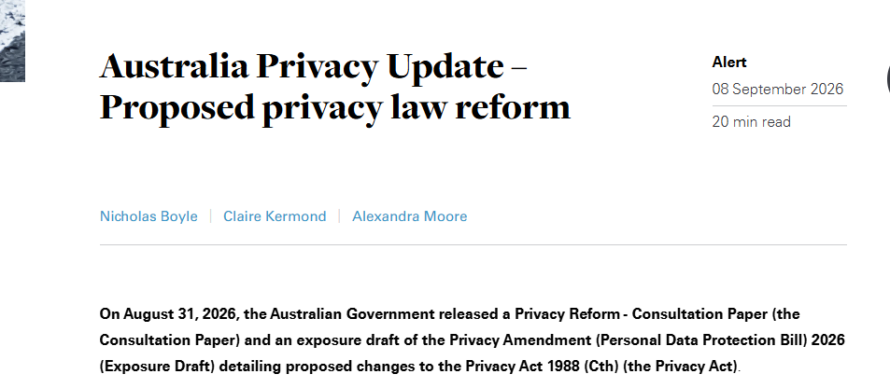
What is privacy
Privacy refers to the ability of individuals to control the access, use of their personal information (e.g., gender, age, phone number, etc) as well as erasure of their data (‘Right to be Forgotten’).
Name | Country/Region | Year Enacted
General Data Protection Regulation (GDPR) | European Union | 2016 (effective 2018)
Privacy Act 1988 | Australia | 1988 (Amended Dec 2024, ongoing consulting 2026)
California Consumer Privacy Act (CCPA) | United States (California) | 2018 (effective 2020)
Personal Information Protection Law (PIPL) | China | 2021

Slide 5
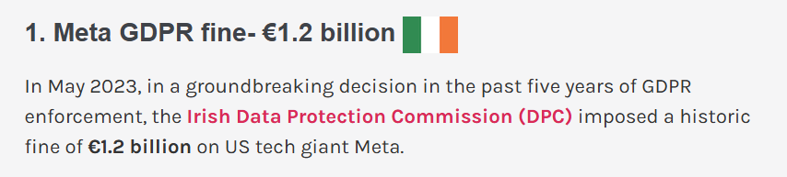
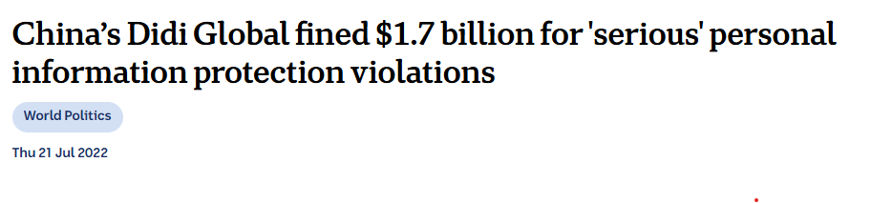
What is privacy
Privacy refers to the ability of individuals to control the access, use of their personal information (e.g., gender, age, phone number, etc) as well as erasure of their data (‘Right to be Forgotten’).

Slide 6
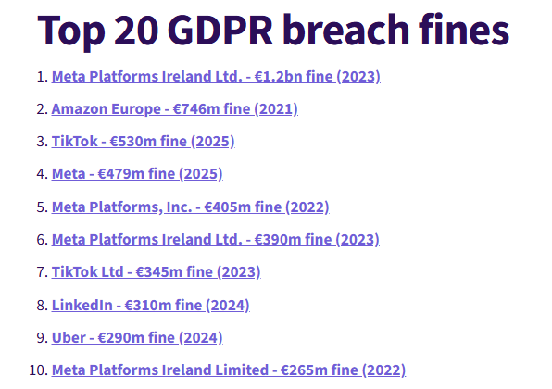
What is privacy
Privacy refers to the ability of individuals to control the access, use of their personal information (e.g., gender, age, phone number, etc) as well as erasure of their data (‘Right to be Forgotten’).
https://www.skillcast.com/blog/20-biggest-gdpr-fines

Slide 7
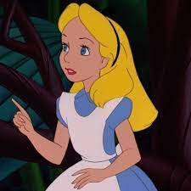

What is Privacy
provides personal information
to sign up for a membership
Alice
Why does Costco collect users’ private data?

Slide 8
What is Privacy
Model Training
provide dataset
Well-trained
Model
e.g., her favourite items

Slide 9
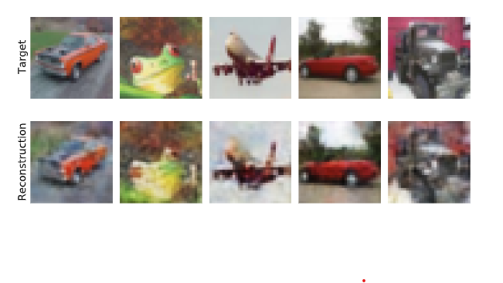
Privacy Inference Attack on Machine Learning
Data Reconstruction Attack
Balle, Borja, Giovanni Cherubin, and Jamie Hayes. "Reconstructing training data with informed adversaries." In 2022 IEEE Symposium on Security and Privacy (SP), pp. 1138-1156. IEEE, 2022.

Slide 10
Privacy Inference Attack on Machine Learning
Data Reconstruction Attack
Personal Identifiable Information Extraction
  e.g., exposing credit card number by querying trained LLM

Slide 11
Privacy Inference Attack on Machine Learning
Data Reconstruction Attack
Personal Identifiable Information Extraction
  e.g., exposing credit card number by querying trained LLM
Membership Inference Attack
  E.g., medical record used for training a disease diagnosis model

Slide 12
Privacy Inference Attack on Machine Learning
Membership Inference Attack
  Hospital publishes/uses a model trained only on patients diagnosed with Condition A (e.g., HIV-positive).
  Attacker has Alice’s medical record and queries the model — it says “20% risk of Condition A” (low). That’s ambiguous.
  Membership inference indicates Alice’s record was in the training set. Attacker now knows Alice belonged to the Condition A cohort (strong, sensitive claim).
  Other model information (e.g., all patients from clinical Z, data collected in 2023). The membership then leaks additional private information.

Slide 13
What is Privacy Preserving
provide anonymized
users’ data
Model Training

Slide 14
What is Privacy Preserving
Privacy preserving (objectives)
  protects data from being disclosed to unauthorized parties
  enables the collection and statistical analysis of data

Slide 15
What is Privacy Preserving
Privacy preserving (objectives)
  protect data from being disclosed to unauthorized parties
  enable the collection, and analysis of data
How to collect and analyze data without leaking private information?

Slide 16
Privacy Preserving
Privacy preserving
  protect data from being disclosed to unauthorized parties
  enable the collection, and analysis of data
How to collect and analyze data without leaking private information?
  Data anonymization: hide personal identifiers that may lead to an individual being identified
    e.g., data masking: remove personally identifiable data such as user names and credit card details.

Slide 17
Privacy Preserving
  Data anonymisation: removing personal identifiers that may lead to an individual being identified
  Data anonymisation is NOT secure enough
    e.g., data linking attack: correlates anonymized data with publicly available data to re-identify individuals.

Slide 18

What is Privacy Preserving
A Hospital
A Third-party
Data Analytics Company
Raw Medical Records
(e.g., patients’ names, genders, ages, diseases, addresses and postcodes)
Data Anonymization
Anonymized Medical Records
(e.g., names, addresses are masked,
while postcodes, genders, ages and diseases are kept)
A Third-party
Data Analytics Company

Slide 19
What is Privacy Preserving
A Hospital
A Third-party
Data Analytics Company
Raw Medical Records
(e.g., patients’ names, gender, age, addresses and postcode)
Public Data
(e.g., voting records and social media profiles)
Data Anonymization
Patient Re-identification
Anonymized Medical Records
(e.g., names and addresses are masked,
while postcodes, gender, age and diseases are kept)
A Third-party
Data Analytics Company

Slide 20
Privacy Preserving
  Data anonymisation: removing personal identifiers that may lead to an individual being identified
  Data anonymisation is NOT secure enough
    Secure multi-party computation
    Differential privacy
    Homomorphic encryption

Slide 21
Secure Multi-party Computation
Secure multi-party computation is a privacy concept that distributes a computation across multiple users where no user can see the other users’ private data.

Slide 22
Secure Multi-party Computation
Secure multi-party computation is a privacy concept that distributes a computation across multiple users where no user can see the other users' private data.
  e.g., additive secret sharing: refers to the division of a secret and its distribution among a group of independent participants.

Slide 23

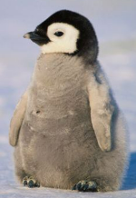
Secure Multi-party Computation
Situation: Three coworkers--Alice, Emu and Penguin—want to compute their average hourly rate
Requirement: They do not want to reveal their own rate to each other.
Alice (A)
$50
Emu (E)
$120
Penguin (P)
$180
https://stock.adobe.com/search?k=emu+cartoon

Slide 24
Secure Multi-party Computation
Steps:
  1. Each staff splits their rate randomly into n (n=3) secret shares
A: $50
E: $120
P: $180

Slide 25
Secure Multi-party Computation
Steps:
  1. Each staff splits their rate randomly into 3 secret shares
A: $50 -> $10, $5, $35
E: $120 -> $25, $100, -$5
P: $180 -> $10, $100, $70
2. Each staff keeps one secret share and distributes the remaining two secret shares to the other two staffs.

Slide 26
Secure Multi-party Computation
After secret sharing is completed:
A | E | P
5 | 35 | 10
100 | 25 | -5
70 | 10 | 100
A = 50
E = 120
P = 180

Slide 27
Secure Multi-party Computation
After secret sharing is completed:
A
5
100
70
A = 50
E = 120
P = 180

Slide 28
Secure Multi-party Computation
After secret sharing is completed:
 | E
 | 35
 | 25
 | 10
A = 50
E = 120
P = 180

Slide 29
Secure Multi-party Computation
After secret sharing is completed:
 |  | P
 |  | 10
 |  | -5
 |  | 100
A = 50
E = 120
P = 180

Slide 30
Secure Multi-party Computation
After secret sharing is completed:
A | E | P
5 | 35 | 10
100 | 25 | -5
70 | 10 | 100
A = 50
E = 120
P = 180

Slide 31
Secure Multi-party Computation
After secret sharing is completed:
A | E | P
5 | 35 | 10
100 | 25 | -5
70 | 10 | 100
175 | 70 | 105
A = 50
Sum: 350
E = 120
P = 180
Sum: 350
Average: 350/3 = 116.67

Slide 32
Secure Multi-party Computation
What are limitations of SMPC in practice?

Slide 33
Secure Multi-party Computation
What are limitations of SMPC in practice?
  e.g., computational overhead and communication cost

Slide 34
Secure Multi-party Computation
What if one coworker is dishonest and distributes false secret shares?
  e.g., Zero Knowledge Proof

Slide 35
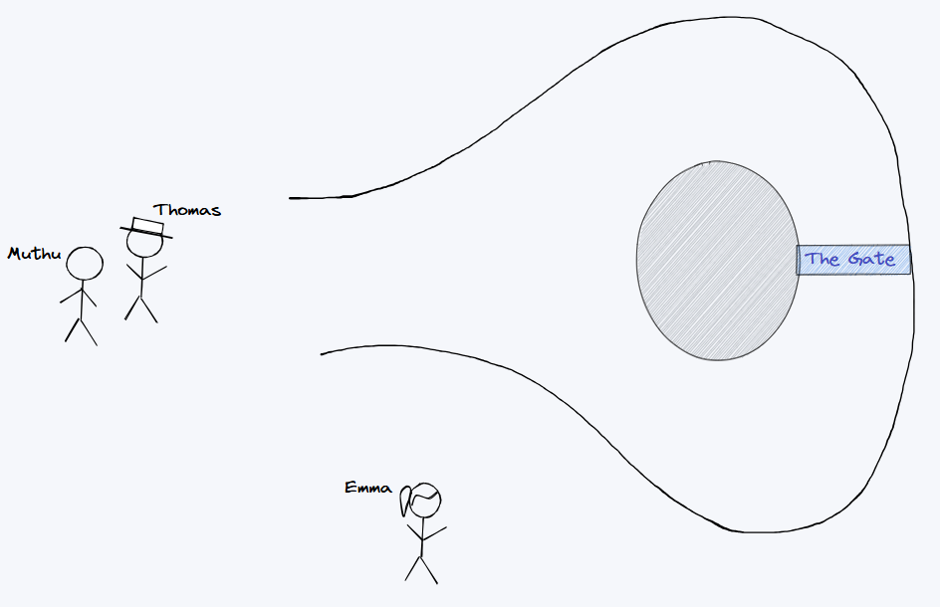
A zero-knowledge proof (ZKP) is a method in which you (the prover) have 3 tasks:
Prove someone (the verifier) that some statement or claim is true.
Do not expose any other information apart from that the statement is true.
Prove it only to the verifier, and nobody else.
https://avestura.dev/blog/zero-knowledge-proofs

Slide 36
Claim: Thomas knows the password of the gate.
Characters:
  Thomas: The prover who wants to prove the claim.
  Muthu: The verifier who wants to verify the proof provided by Thomas.
  Emma: An unknown stranger who happens to be in the scene. In a zero-knowledge proof, Emma shouldn’t be able to verify the proof even with eavesdropping.
https://avestura.dev/blog/zero-knowledge-proofs

Slide 37
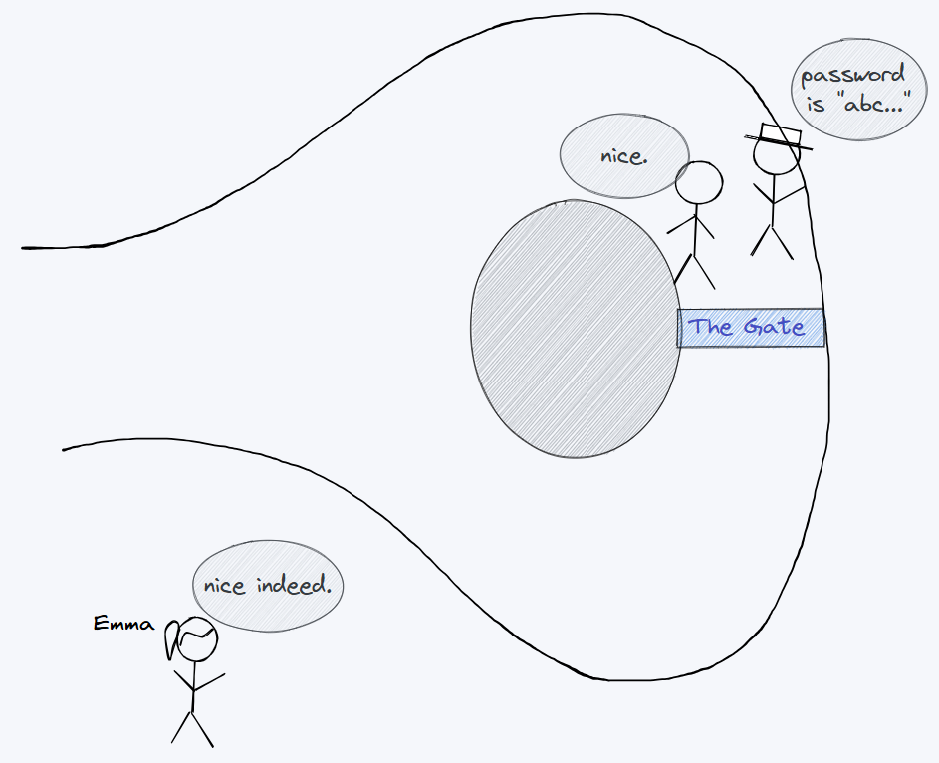
Strategy #1: Just tell Muthu the password.
Task 1: ✅ Prove Muthu that the claim is true.
Task 2: ❌ Do not expose any other information.
Task 3: ❌ Prove it only to the verifier.

Slide 38
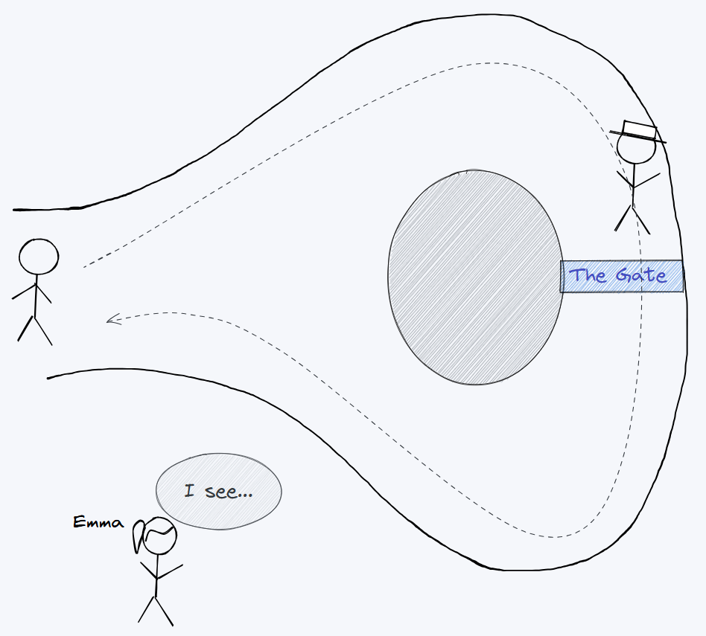
Strategy #2: Thomas enters from one side of the cave and exits from the other side, while Muthu is watching him at the entrance.
Task 1: ✅ Prove Muthu that the claim is true.
Task 2: ✅ Do not expose any other information.
Task 3: ❌ Prove it only to the verifier.

Slide 39
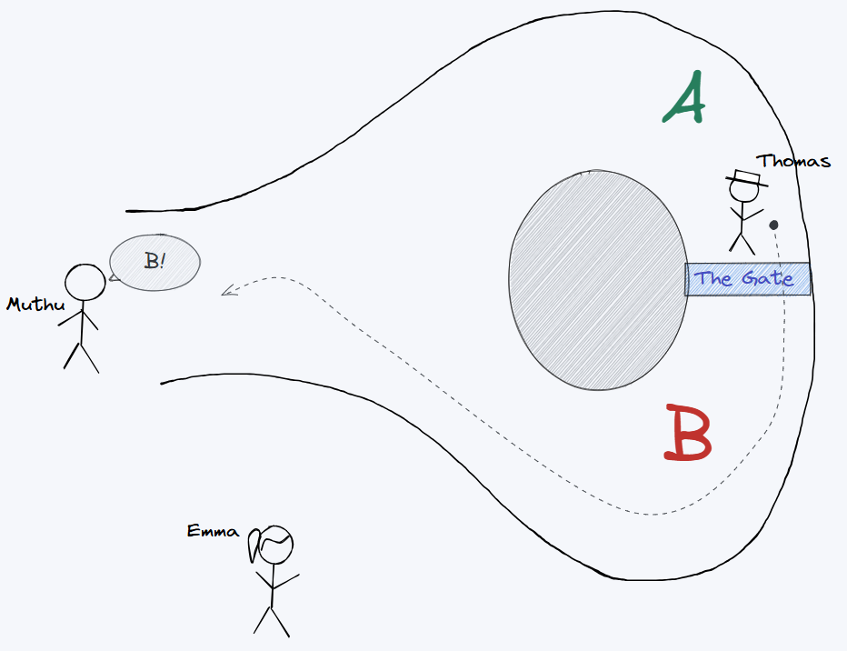
Strategy #3: Muthu doesn’t see from which side Thomas enters the cave. Thomas picks the entrance path randomly, but Muthu decides which side Thomas should exit from.
Task 1: ✅ Prove Muthu that the claim is true.
Task 2: ✅ Do not expose any other information.
Task 3: ✅ Prove it only to the verifier.

Slide 40
Differential Privacy
Differential privacy (DP) is also a concept in privacy that aims to provide strong guarantees for protecting the privacy of individuals in a dataset while allowing statistical analysis of the dataset.

Slide 41
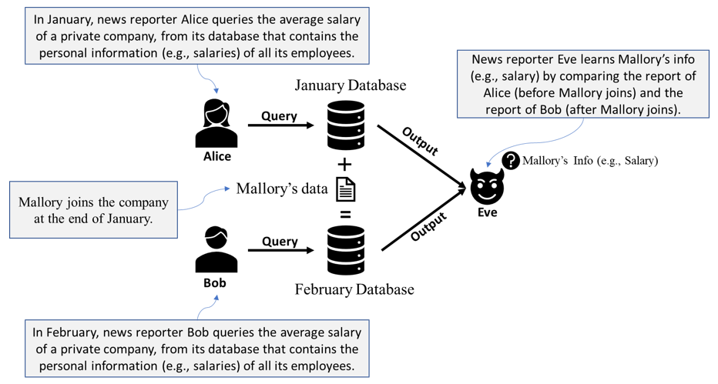
User Privacy Inference

Slide 42
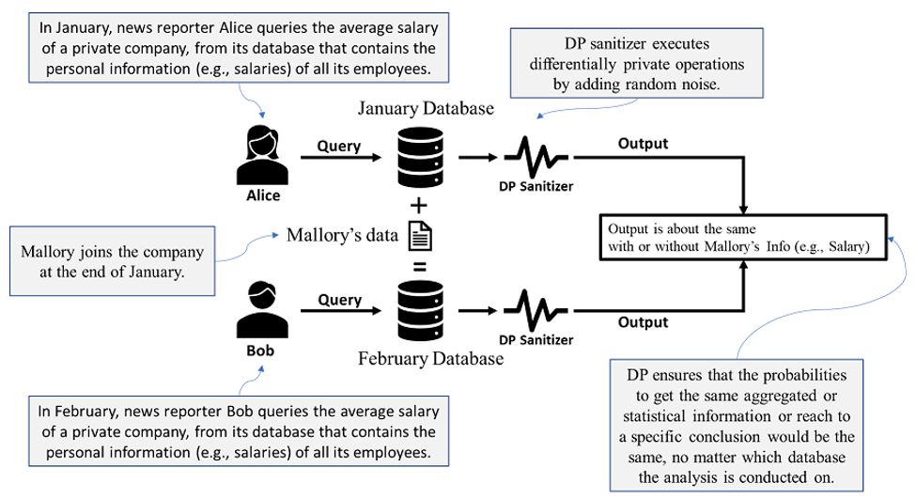
Differential Privacy

Slide 43
Differential Privacy
Differential privacy (DP) is also a concept in privacy that aims to provide strong guarantees for protecting the privacy of individuals in a dataset while allowing statistical analysis of the dataset.
The key difference between DP and SMPC
  DP focuses on a statistical analysis of a dataset
  SMPC focuses on multiple parties that perform a collaborative computation

Slide 44
Homomorphic Encryption
Homomorphic Encryption (HE) is a type of encryption that allows computations to be performed on encrypted data, making itself computationally expensive.

Slide 45
Homomorphic Encryption
Homomorphic Encryption (HE) is a type of encryption that allows computations to be performed on encrypted data, making itself computationally expensive.
HE
encryption
computing
operation
HE
decryption
Encrypted
Texts
Encrypted
Computation Results
Decrypted Computation Results
Plaintext
homomorphically same computing operation
Computation Results

Slide 46



Homomorphic Encryption
Scenario: Medical Diagnosis
Cloud Server
Computed Result:
F(E(A), E(B))
Ciphertext E(A)
Ciphertext E(B)
Computing Request:
F()
HE Encryption
HE Decryption
Plaintext A
Plaintext B
Decrypted Computed Result:
D(F(E(A), E(B)))
F(A, B)
Alice

Slide 47
Homomorphic Encryption
Fully HE (FHE) enables any computations to be performed on encrypted data, both addition and multiplication. An infinite number of times,
  e.g., BGV (Brakerski-Gentry-Vaikuntanathan)

Slide 48
Homomorphic Encryption
Fully HE (FHE) enables any computations to be performed on encrypted data, both addition and multiplication. An infinite number of times,
  e.g., BGV (Brakerski-Gentry-Vaikuntanathan)
Partially HE (PHE) enables one type of computations (either addition or multiplication) to be performed on encrypted data. An infinite number of times.
  e.g., RSA (homomorphic multiplication)
    Paillier (homomorphic addition)

Slide 49
Homomorphic Encryption
Fully HE (FHE) enables any computations to be performed on encrypted data, both addition and multiplication. An infinite number of times,
  e.g., BGV (Brakerski-Gentry-Vaikuntanathan)
Partially HE (PHE) enables one type of computations (either addition or multiplication) to be performed on encrypted data. An infinite number of times.
  e.g., RSA (homomorphic multiplication)
    Paillier (homomorphic addition)
Somewhat HE (SHE) enables both addition and multiplication, but for a limited number of times

Slide 50
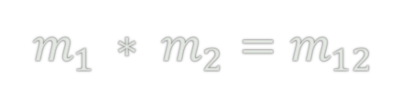

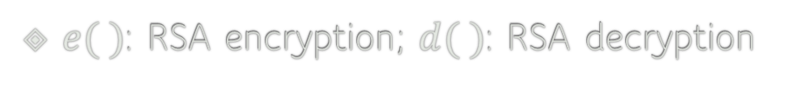
RSA: Homomorphic Multiplication
$e( )$: RSA encryption; $d( )$: RSA decryption
$$m_{1 }∗ m_{2}=m_{12}$$
$${e(m}_{1 })∗{e(m}_{2 })={e(m}_{1 }∗ m_{2})=e(m_{12})$$
Homomorphic Multiplication
$${d(e\left(m_{12}\right))=d(e(m}_{1 }) ∗{e(m}_{2 }))=m_{1 }∗ m_{2}$$

Slide 51
RSA Algorithm Overview
RSA Key Generation
• Choose two primes: p, q, The prime numbers need to be large so that they will be difficult for someone to figure out.
• Compute: n = p × q, φ(n) = (p − 1)(q − 1)
• Choose public exponent e such that e is co-prime to φ(n)
• Compute private exponent d such that e × d ≡ 1 mod φ(n)
RSA Operations
• Public key: (e, n)
• Private key: d
• Encryption: c = m^e mod n
• Decryption: m = c^d mod n
Note: Two integers are co-prime if the only positive integer that divides them is 1

Slide 52
RSA: Homomorphic Multiplication
RSA Setup:
- p = 3, q = 11 → n = 33
- φ(n) = (p-1)(q-1) = 20
- e = 3, d = 7 (since 3×7 ≡ 1 mod 20)
- Public key: (n=33, e=3)
- Private key: d = 7
Encrypting Plaintexts:
- m₁ = 4 → c₁ = 4³ mod 33 = 64 mod 33 = 31
- m₂ = 5 → c₂ = 5³ mod 33 = 125 mod 33 = 26

Slide 53
RSA: Homomorphic Multiplication
RSA Setup:
- p = 3, q = 11 → n = 33
- φ(n) = (p-1)(q-1) = 20
- e = 3, d = 7 (since 3×7 ≡ 1 mod 20)
- Public key: (n=33, e=3)
- Private key: d = 7
Multiply Ciphertexts:
- c = c₁ × c₂ mod 33 = 31 × 26 mod 33 = 806 mod 33 = 14
Encrypting Plaintexts:
- m₁ = 4 → c₁ = 4³ mod 33 = 64 mod 33 = 31
- m₂ = 5 → c₂ = 5³ mod 33 = 125 mod 33 = 26

Slide 54
RSA: Homomorphic Multiplication
RSA Setup:
- p = 3, q = 11 → n = 33
- φ(n) = (p-1)(q-1) = 20
- e = 3, d = 7 (since 3×7 ≡ 1 mod 20)
- Public key: (n=33, e=3)
- Private key: d = 7
Multiply Ciphertexts:
- c = c₁ × c₂ mod 33 = 31 × 26 mod 33 = 806 mod 33 = 14
Decrypt Result:
- c = 14 → m = 14⁷ mod 33 = 20
- Expected: 4 × 5 = 20
Encrypting Plaintexts:
- m₁ = 4 → c₁ = 4³ mod 33 = 64 mod 33 = 31
- m₂ = 5 → c₂ = 5³ mod 33 = 125 mod 33 = 26

Slide 55
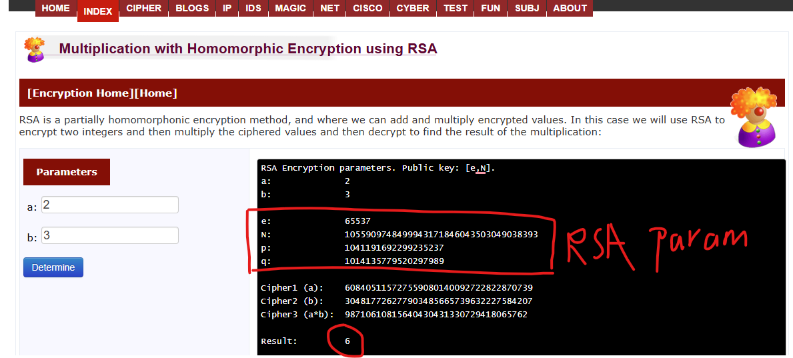
RSA: Homomorphic Multiplication
$e( )$: RSA encryption; $d( )$: RSA decryption
$$m_{1 }∗ m_{2}=m_{12}$$
$${e(m}_{1 })∗{e(m}_{2 })={e(m}_{1 }∗ m_{2})=e(m_{12})$$
Homomorphic Multiplication
$${d(e\left(m_{12}\right))=d(e(m}_{1 }) ∗{e(m}_{2 }))=m_{1 }∗ m_{2}$$
https://asecuritysite.com/encryption/hom_rsa

Slide 56
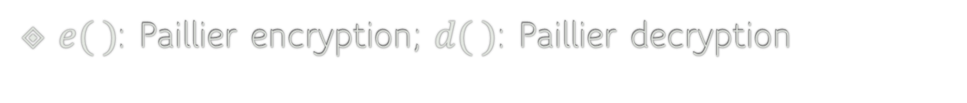
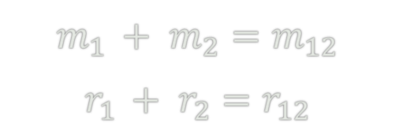
Paillier: Homomorphic Addition
Pascal Paillier in 1999
$e( )$: Paillier encryption; $d( )$: Paillier decryption
$$m_{1 }+ m_{2}=m_{12}$$
$$r_{1 }+ r_{2}=r_{12}$$
$${e(m}_{1 }, r_{1 })∗{e(m}_{2 }, r_{2 })={e(m}_{1 }+ m_{2}, r_{1 }+ r_{2})=e(m_{12}, r_{12})$$
Homomorphic Addition
$${d(e\left(m_{12}, r_{12}\right))=d(e(m}_{1 },r_{1 }) ∗e(m_{2}, r_{2}))=m_{1 }+ m_{2}, r_{1 }+ r_{2}$$
When two ciphertexts are multiplied, the result decrypts to the sum of their plaintexts
https://asecuritysite.com/homomorphic/pal

Slide 57
Homomorphic Encryption
What are the pros and cons of HE?

Slide 58
Homomorphic Encryption
What are the pros and cons of HE?
Pros:
  HE allows computation on encrypted data, ensuring data privacy.
  HE is versatile as it can be used for many privacy-preserving tasks (e.g., Deep Learning model training or inference).
Cons:
  HE is computationally expensive, and the computational overhead increases with the complexity of the computation.

Slide 59
What is a Side-Channel Attack?
Cryptography ≠ Always Safe
Strong algorithms can be broken by watching how they run!

Slide 60
What is a Side-Channel Attack?
Doesn't break the algorithm directly
Collects indirect clues (side channels) from a running device

Slide 61
Examples of Side Channels:
⏱️ Timing: How long operations take
🔌 Power usage: How much power is drawn
🔊 Sound: Noise from hardware
🌡️ Heat: Temperature changes
💡 EM emissions: Tiny electromagnetic leaks

Slide 62
Real-World Example:
Can you steal the PIN when someone enter a PIN in the ATM?

Slide 63
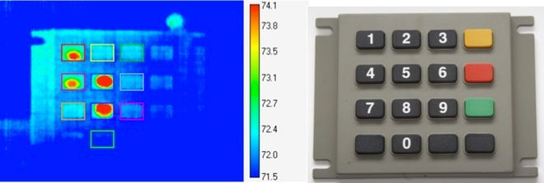
Real-World Example:
Watching someone enter a PIN
Can’t see the numbers, but hears clicks or sees movement (e.g., shoulder surfing attack)
Eventually, they figure it out!
Thermal Imaging
Mowery, Keaton, Sarah Meiklejohn, and Stefan Savage. "Heat of the moment: Characterizing the efficacy of thermal {Camera-Based} attacks." In 5th USENIX Workshop on Offensive Technologies (WOOT 11). 2011.

Slide 64
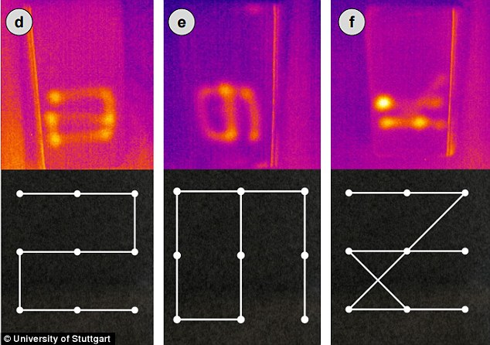
Real-World Example:
Watching someone enter a PIN
Can’t see the numbers, but hears clicks or sees movement (e.g., shoulder surfing attack)
Eventually, they figure it out!
https://www.theinvestigators.co.nz/news/thieves-can-steal-your-smartphone-pin-code-in-seconds-using-thermal-cameras

Slide 65
Takeaway
Side-channel attacks exploit leaks in the real world,
Not just flaws in the math!

Slide 66
How Does it Leak a Secret Key?
1. Encryption uses the key to scramble data
2. Attacker watches timing/power patterns
3. Repeats with different inputs
4. Uses patterns to guess parts of the key

Slide 67
RSA Algorithm Overview
RSA Key Generation
• Choose two primes: p, q, The prime numbers need to be large so that they will be difficult for someone to figure out.
• Compute: n = p × q, φ(n) = (p − 1)(q − 1)
• Choose public exponent e such that e is co-prime to φ(n)
• Compute private exponent d such that e × d ≡ 1 mod φ(n)
RSA Operations
• Public key: (e, n)
• Private key: d
• Encryption: c = m^e mod n
• Decryption: m = c^d mod n
Note: Two integers are co-prime if the only positive integer that divides them is 1

Slide 68
RSA Example (Tiny Numbers)
Example RSA Setup
• p = 3, q = 11 → n = 33
• φ(n) = (3 − 1)(11 − 1) = 2 × 10 = 20
• Choose e = 3
• Find d such that 3 × d ≡ 1 mod 20 → d = 7
• Public key: (3, 33)
• Private key: 7

Slide 69
Encryption & Decryption with Square-and-Multiply
Example 1:
m = 4, c → 4^3 % 33 = 31
d = 7 → Binary = 111
1. Initial result = 1
2. Bits: 1 1 1
- (1^2 * 31) % 33 = 31
- (31^2 * 31) % 33 = 28
- (28^2 * 31) % 33 = 4
Final result = 4
Decryption Process

Slide 70
Encryption & Decryption with Square-and-Multiply
Example 2: d = 12 → Binary = 1100
1. Initial result = 1
2. Bits: 1 1 0 0
- (1^2 * 31) % 33 = 31
- (31^2 * 31) % 33 = 28
- (28^2) % 33 = 25
- (25^2) % 33 = 31
Final result = 31
Decryption Process

Slide 71
Encryption & Decryption with Square-and-Multiply
Example 3: d = 33 → Binary = 100001
1. Initial result = 1
2. Bits: 1 0 0 0 0 1
- (1^2 * 31) % 33 = 31
- (31^2) % 33 = 4
- (4^2) % 33 = 16
- (16^2) % 33 = 25
- (25^2) % 33 = 31
- (31^2 * 31) % 33 = 28
Final result = 28

Slide 72
Square-and-Multiply Algorithm (C Code)
int square_and_multiply(int base, int exp, int mod) {
int result = 1;
base = base % mod;
while (exp > 0) {
if (exp % 2 == 1)
result = (result * base) % mod; // Multiply
base = (base * base) % mod; // Always square
exp = exp / 2;
}
return result;
}
// Side-channel attacks exploit the branching behavior:
// Multiply happens only when the bit of exp is 1 → leaks key bits.

Slide 73
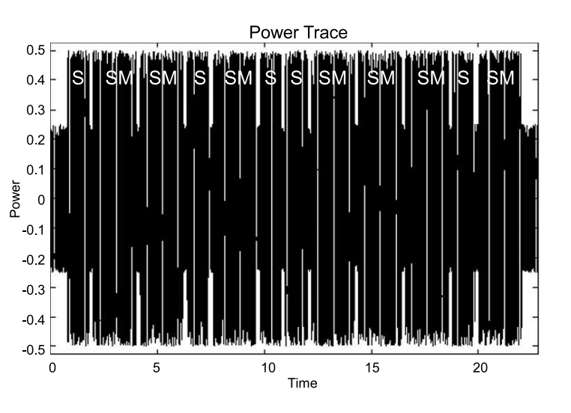
Vulnerability Insight
Square-and-Multiply:
• If bit = 0 → only square
• If bit = 1 → square and multiply
Power/timing side channels reveal:
• Which bits trigger multiplication
• → Attacker reconstructs d
0
1
1
0
Understanding Cryptography: A textbook for students, Page 197

